Slide 1
NCIt:C35813: Hematopoietic and Lymphoid System Neoplasm
Survival Analysis
Patricia Freitag and Serena Galli

Slide 2
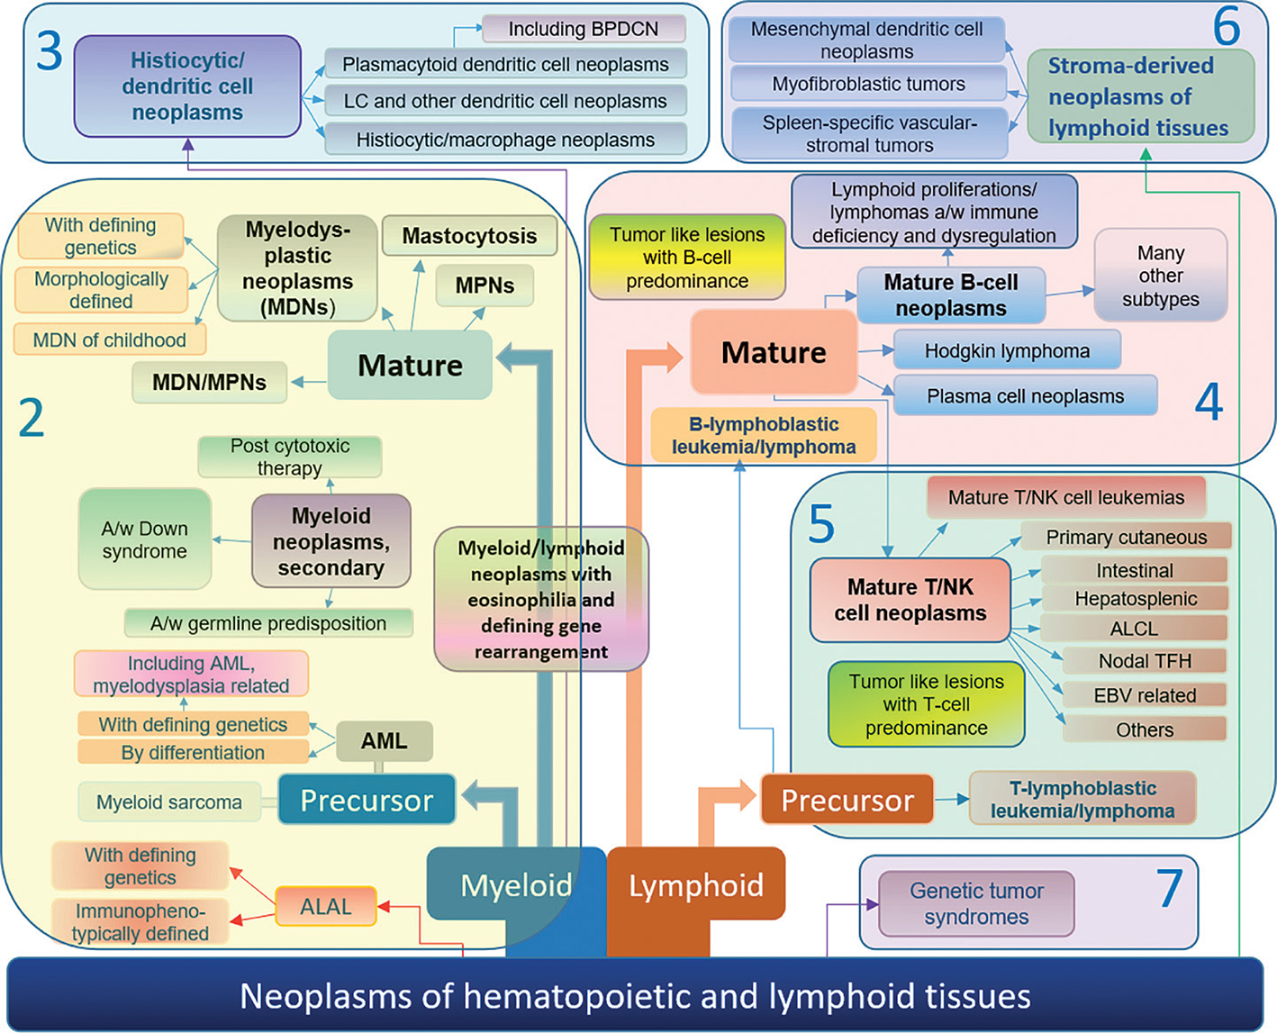
WHO classification of hematolymphoid tumors
Li, Weijie. “The 5th Edition of the World Health Organization Classification of Hematolymphoid Tumors.” Leukemia, edited by Weijie Li, Exon Publications, 16 October 2022. doi:10.36255/exon-publications-leukemia-who-5th-edition-hematolymphoid-tumors
Notes:
https://exonpublications.com/index.php/exon/article/view/who-5th-edition-hematolymphoid-tumors/1241#figures

Slide 3
WHO classification of hematolymphoid tumors
Li, Weijie. “The 5th Edition of the World Health Organization Classification of Hematolymphoid Tumors.” Leukemia, edited by Weijie Li, Exon Publications, 16 October 2022. doi:10.36255/exon-publications-leukemia-who-5th-edition-hematolymphoid-tumors
Notes:
https://exonpublications.com/index.php/exon/article/view/who-5th-edition-hematolymphoid-tumors/1241#figures

Slide 4
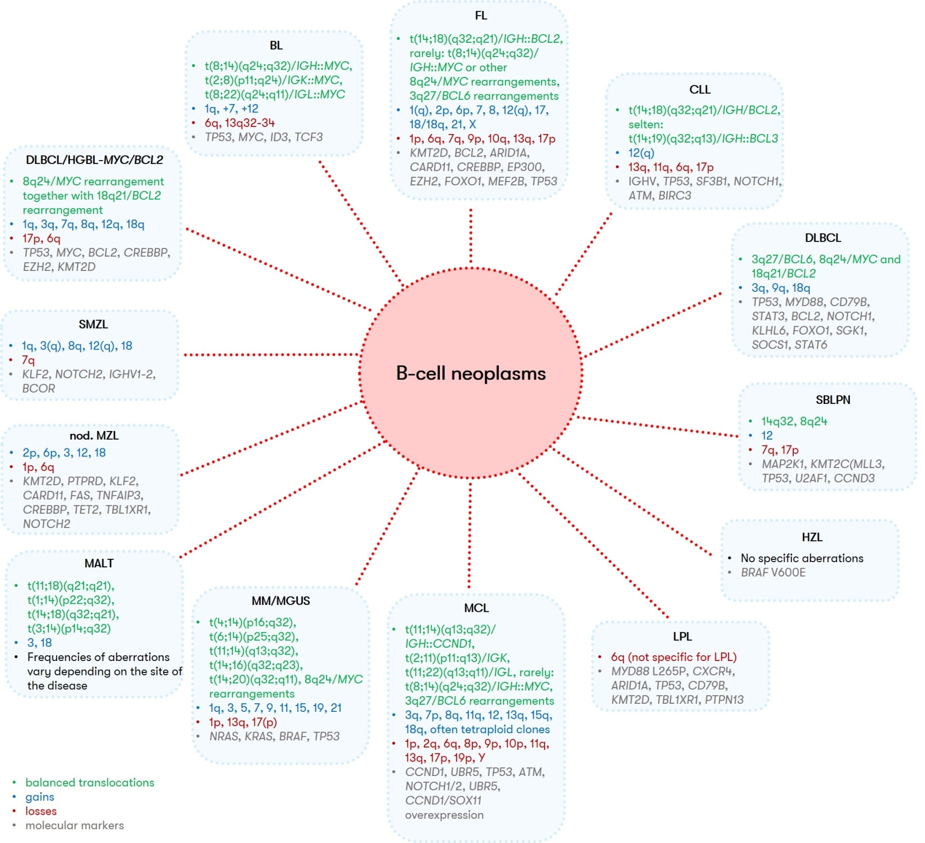
Mature B-cell Neoplasms
+8q: MYC
-17p: TP53
CLL (Chronic Lymphatic Leukemia)
7% of mature B-cell lymphomas
incidence: 4.6/100 000 per year
TP53 mutations and 17p- confer poor prognosis
5-year OS: 80-90%
https://www.mll.com/en/mature-b-cell-neoplasms/mature-b-cell-neoplasms-overview
Notes:
https://www.sciencedirect.com/science/article/pii/S0006497120617037?pes=vor

Slide 5
Mature B-cell Neoplasms
+8q: MYC
-17p: TP53
MCL (Mantle Cell Lymphoma)
3% of B cell lymphomas
incidence : 1-2/100 000 per year
TP53 mutations confer poor prognosis, conflicting data regarding prognostic impact of -17p and +8q
5-year OS: 58%
https://www.mll.com/en/mature-b-cell-neoplasms/mature-b-cell-neoplasms-overview
Notes:
https://www.sciencedirect.com/science/article/pii/S0006497120617037?pes=vor
Rare form of BCL, aggressive vs. Indolent forms

Slide 6
Mature B-cell Neoplasms
+8q: MYC
-17p: TP53
DLBCL (Diffuse Large B Cell Lymphoma)
30% of mature B-cell lymphomas
incidence: 6/100 000 per year
5-year OS: 65%
DLBCL/HGBL-MYC/BCL2:
6-10% of all DLBCL
-17p and +8q recurrent findings
associated with poor prognosis
https://www.mll.com/en/mature-b-cell-neoplasms/mature-b-cell-neoplasms-overview
Notes:
https://www.sciencedirect.com/science/article/pii/S0006497120617037?pes=vor
DLBCL
The who2 recognizes an aggressive subtype characterices by a MYC and BCL rearrangement, in this subtype

Slide 7
Aims
Occurence of -17p (TP53) and +8q (MYC) in different hematolymphoid neoplasms
Survival analysis for CLL, MCL and DLBCL patients with regard to 17p and 8q status

Slide 8
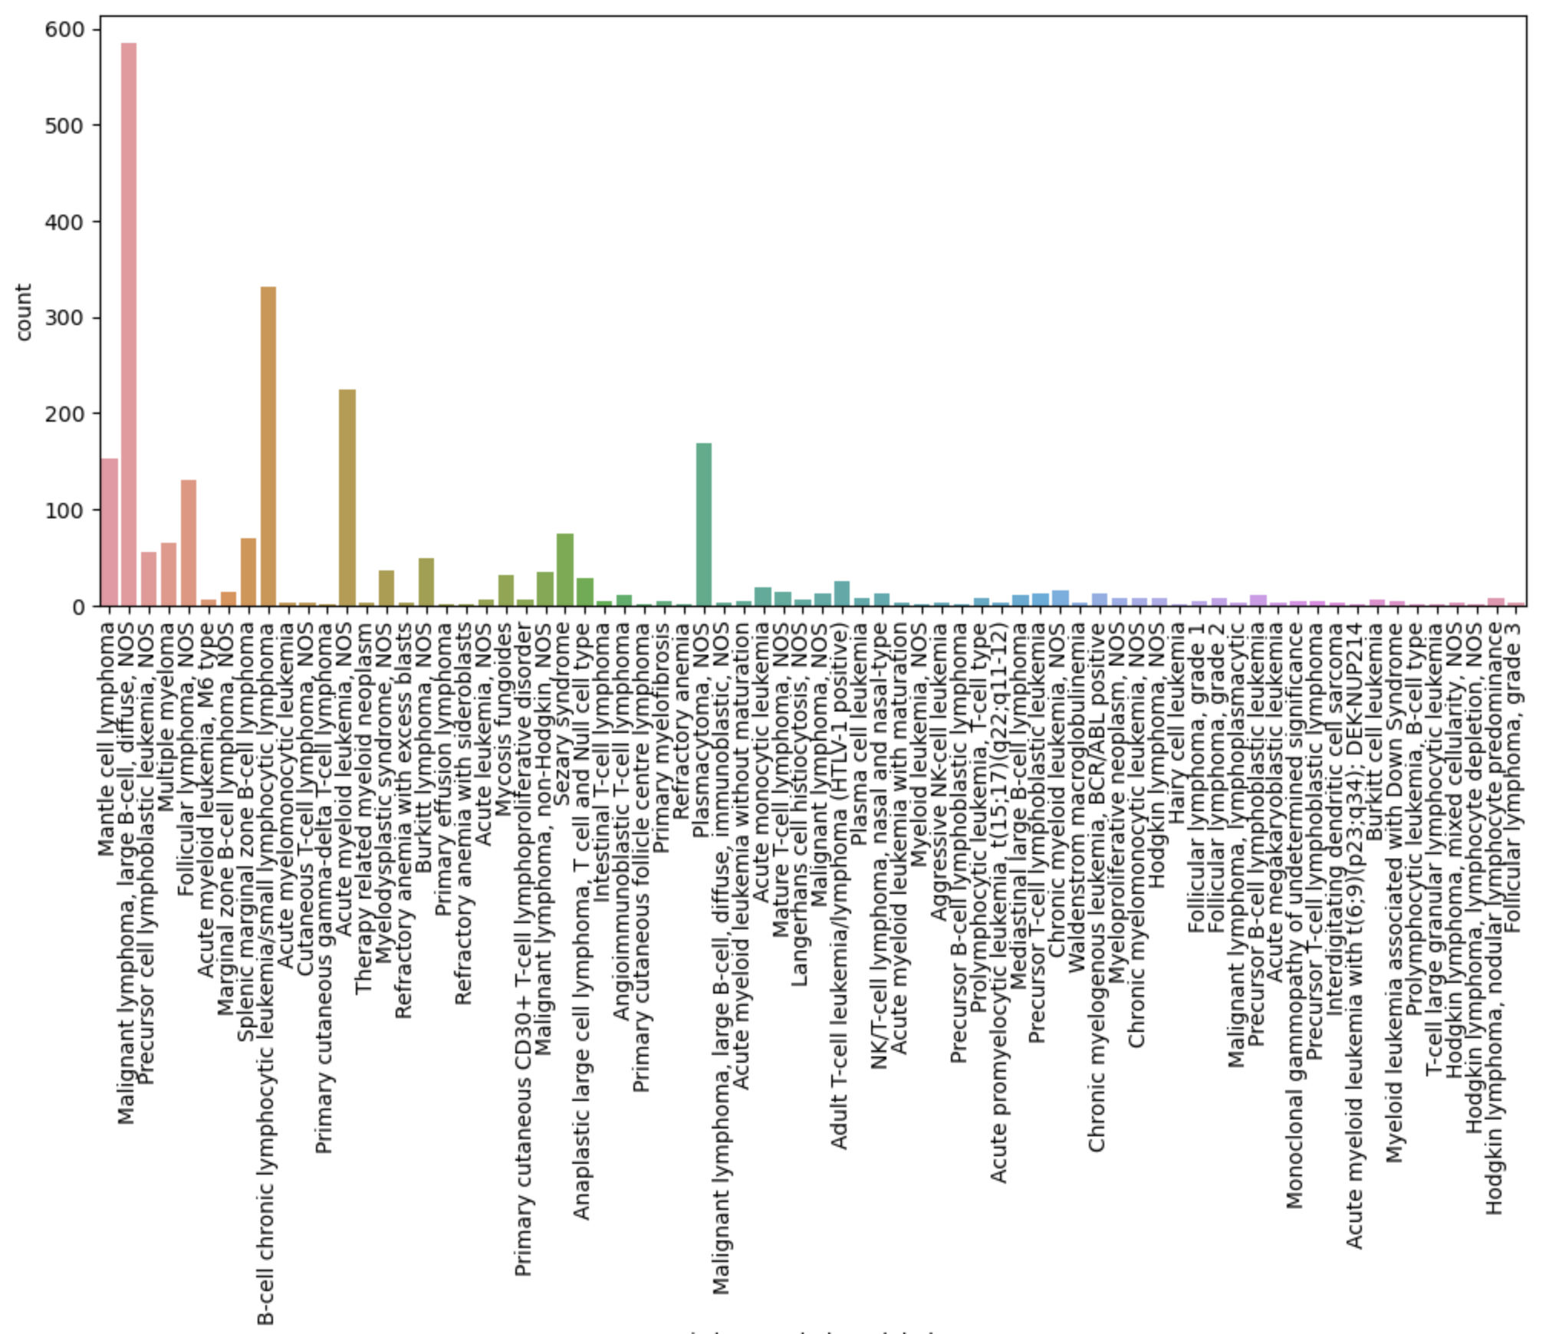
Occurrence of -17p (TP53)

Slide 9
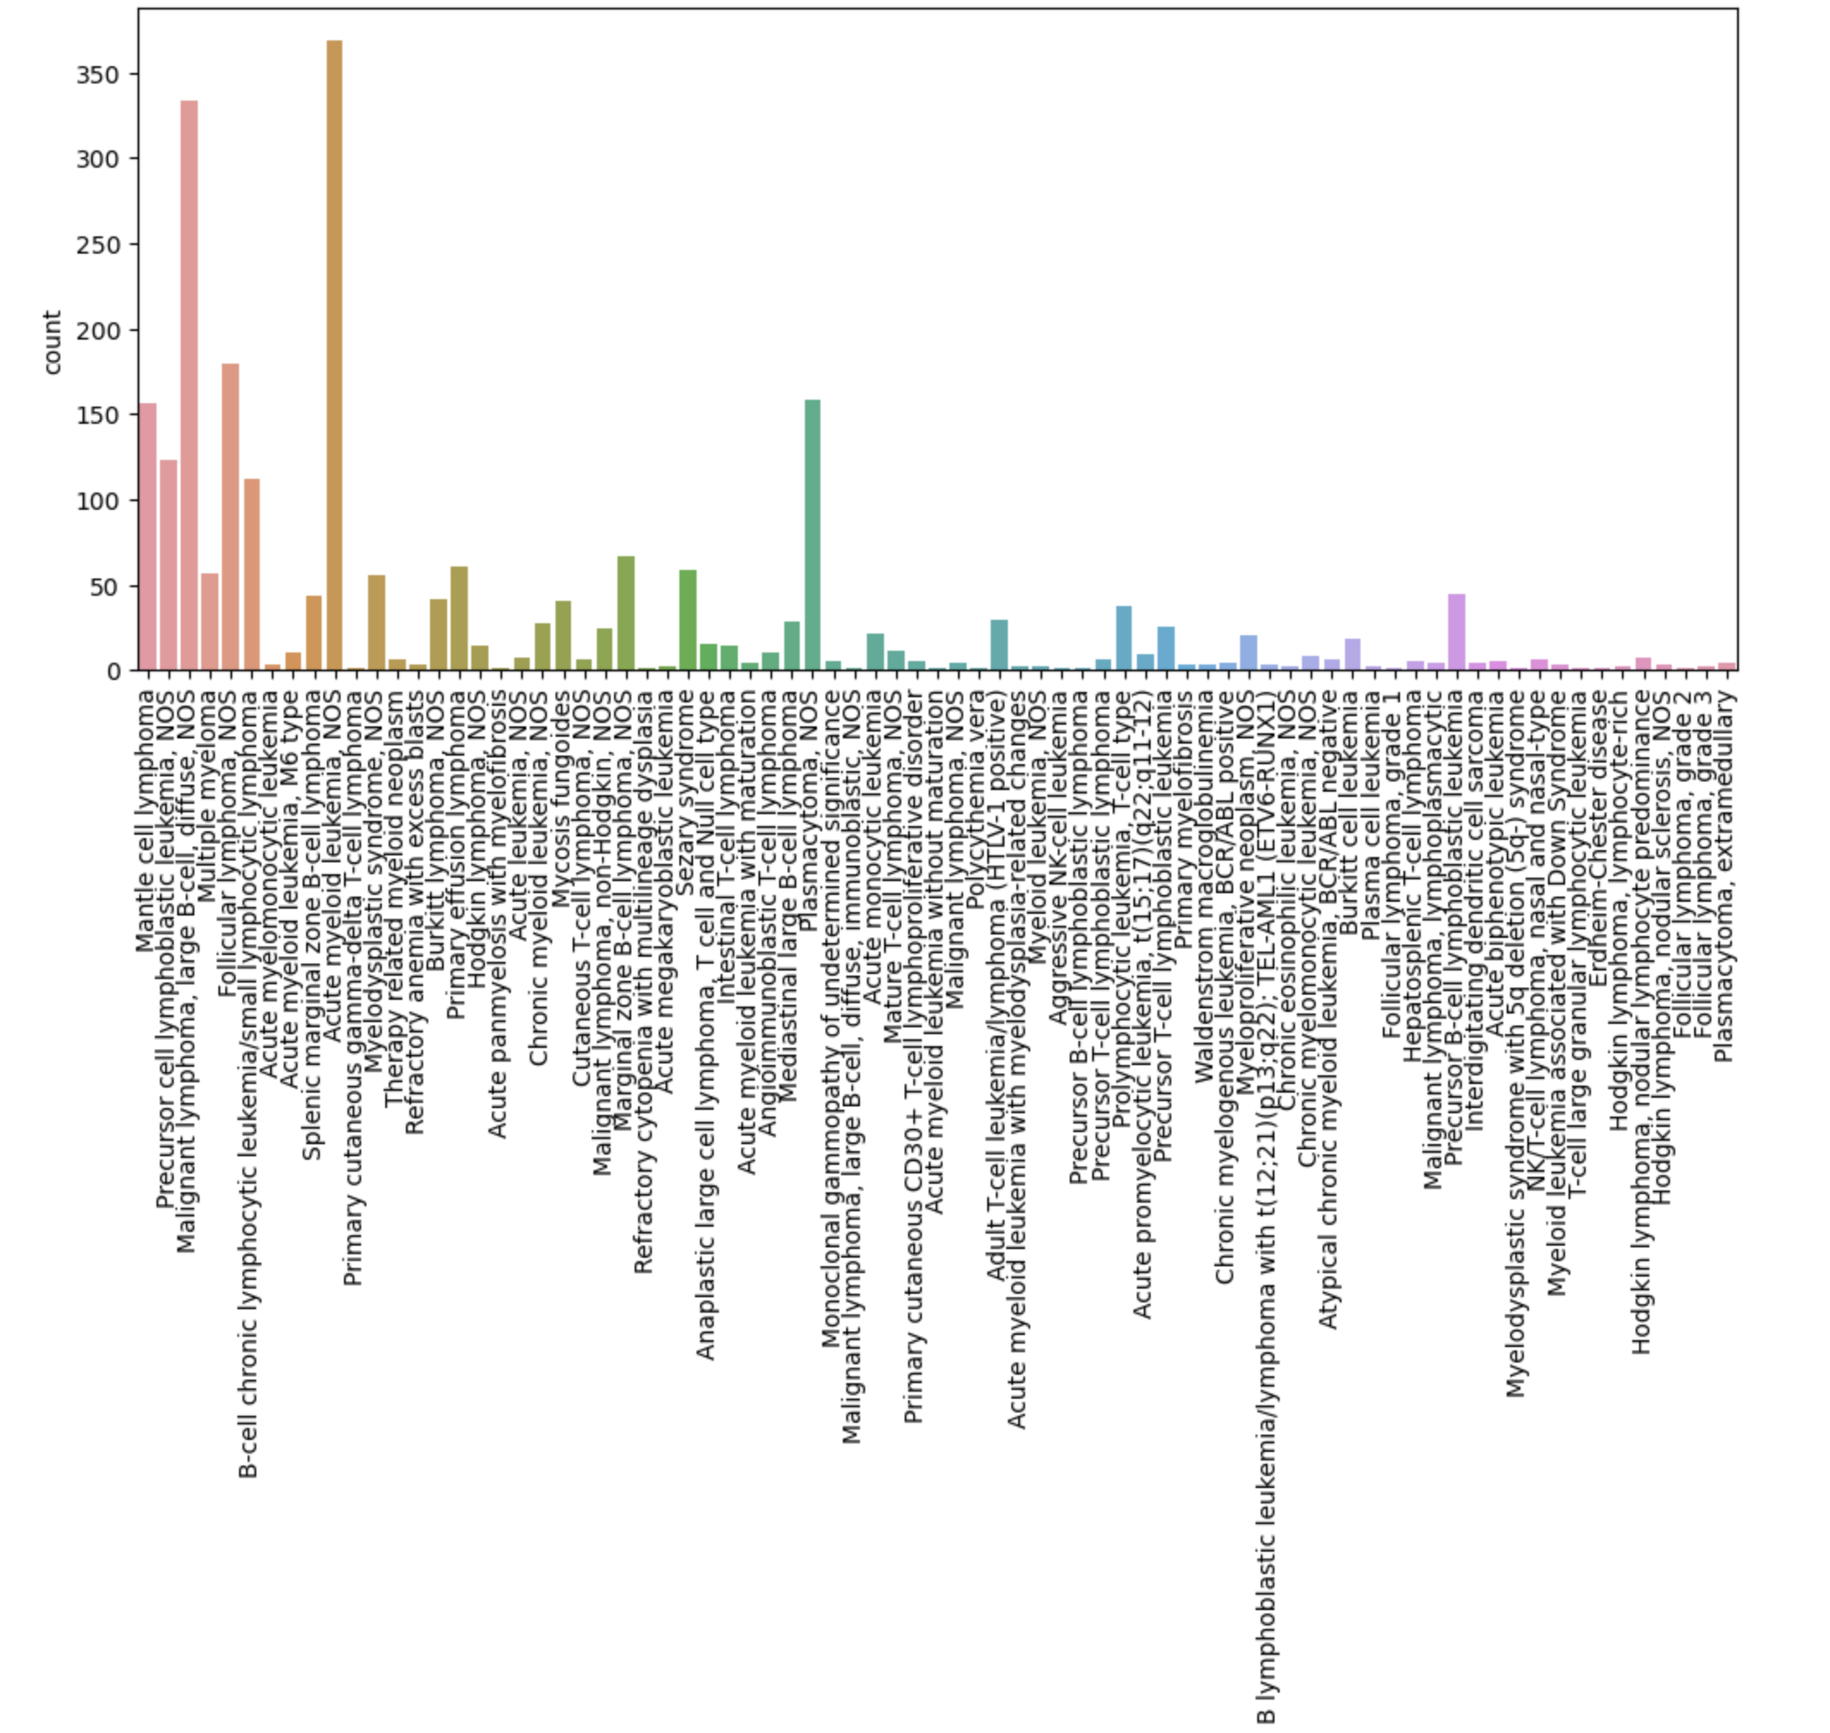
Occurrence of +8q (MYC)

Slide 10
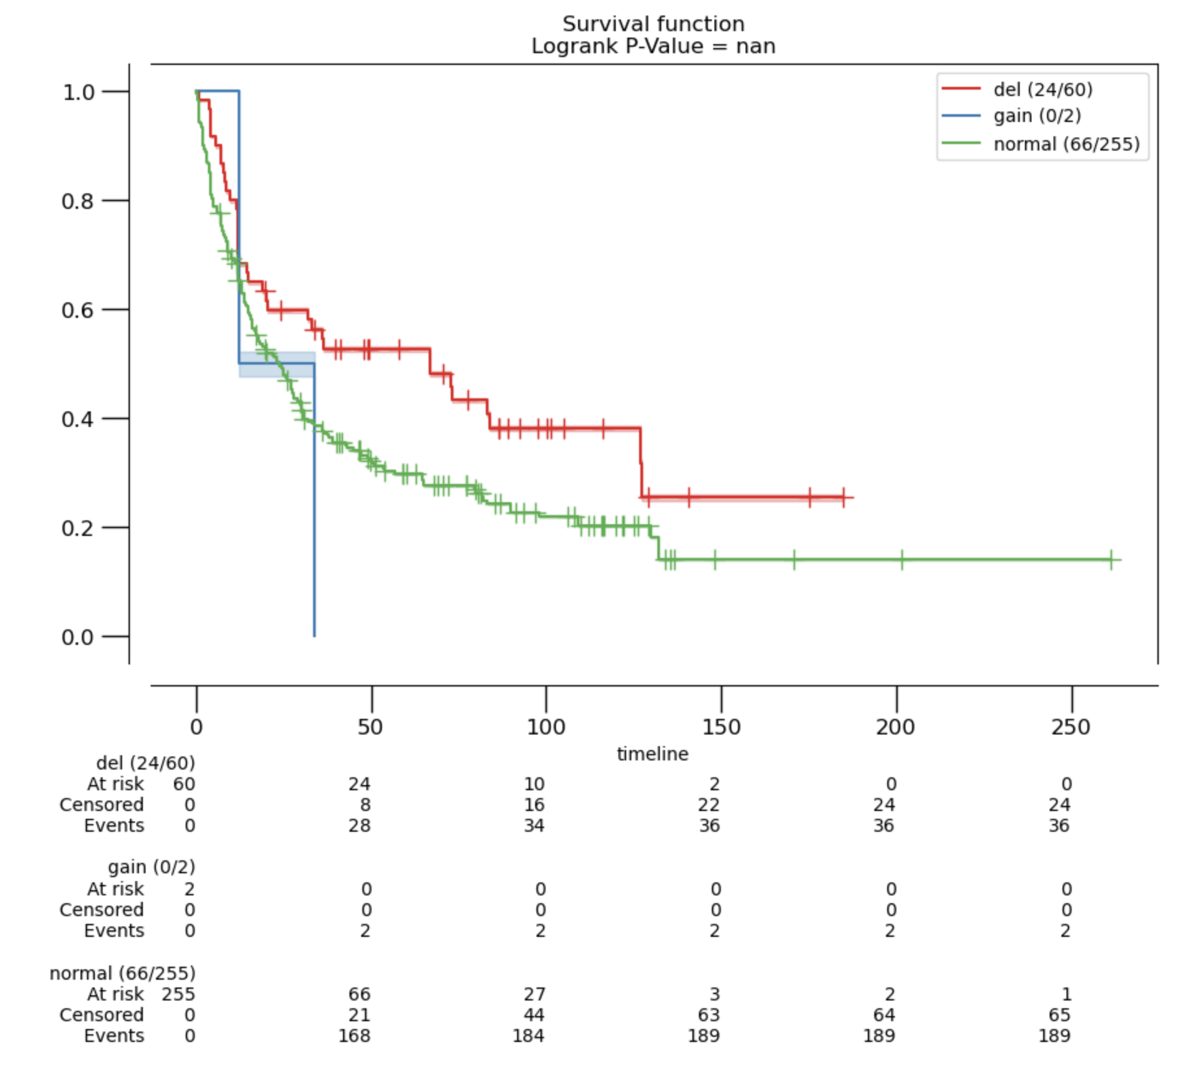
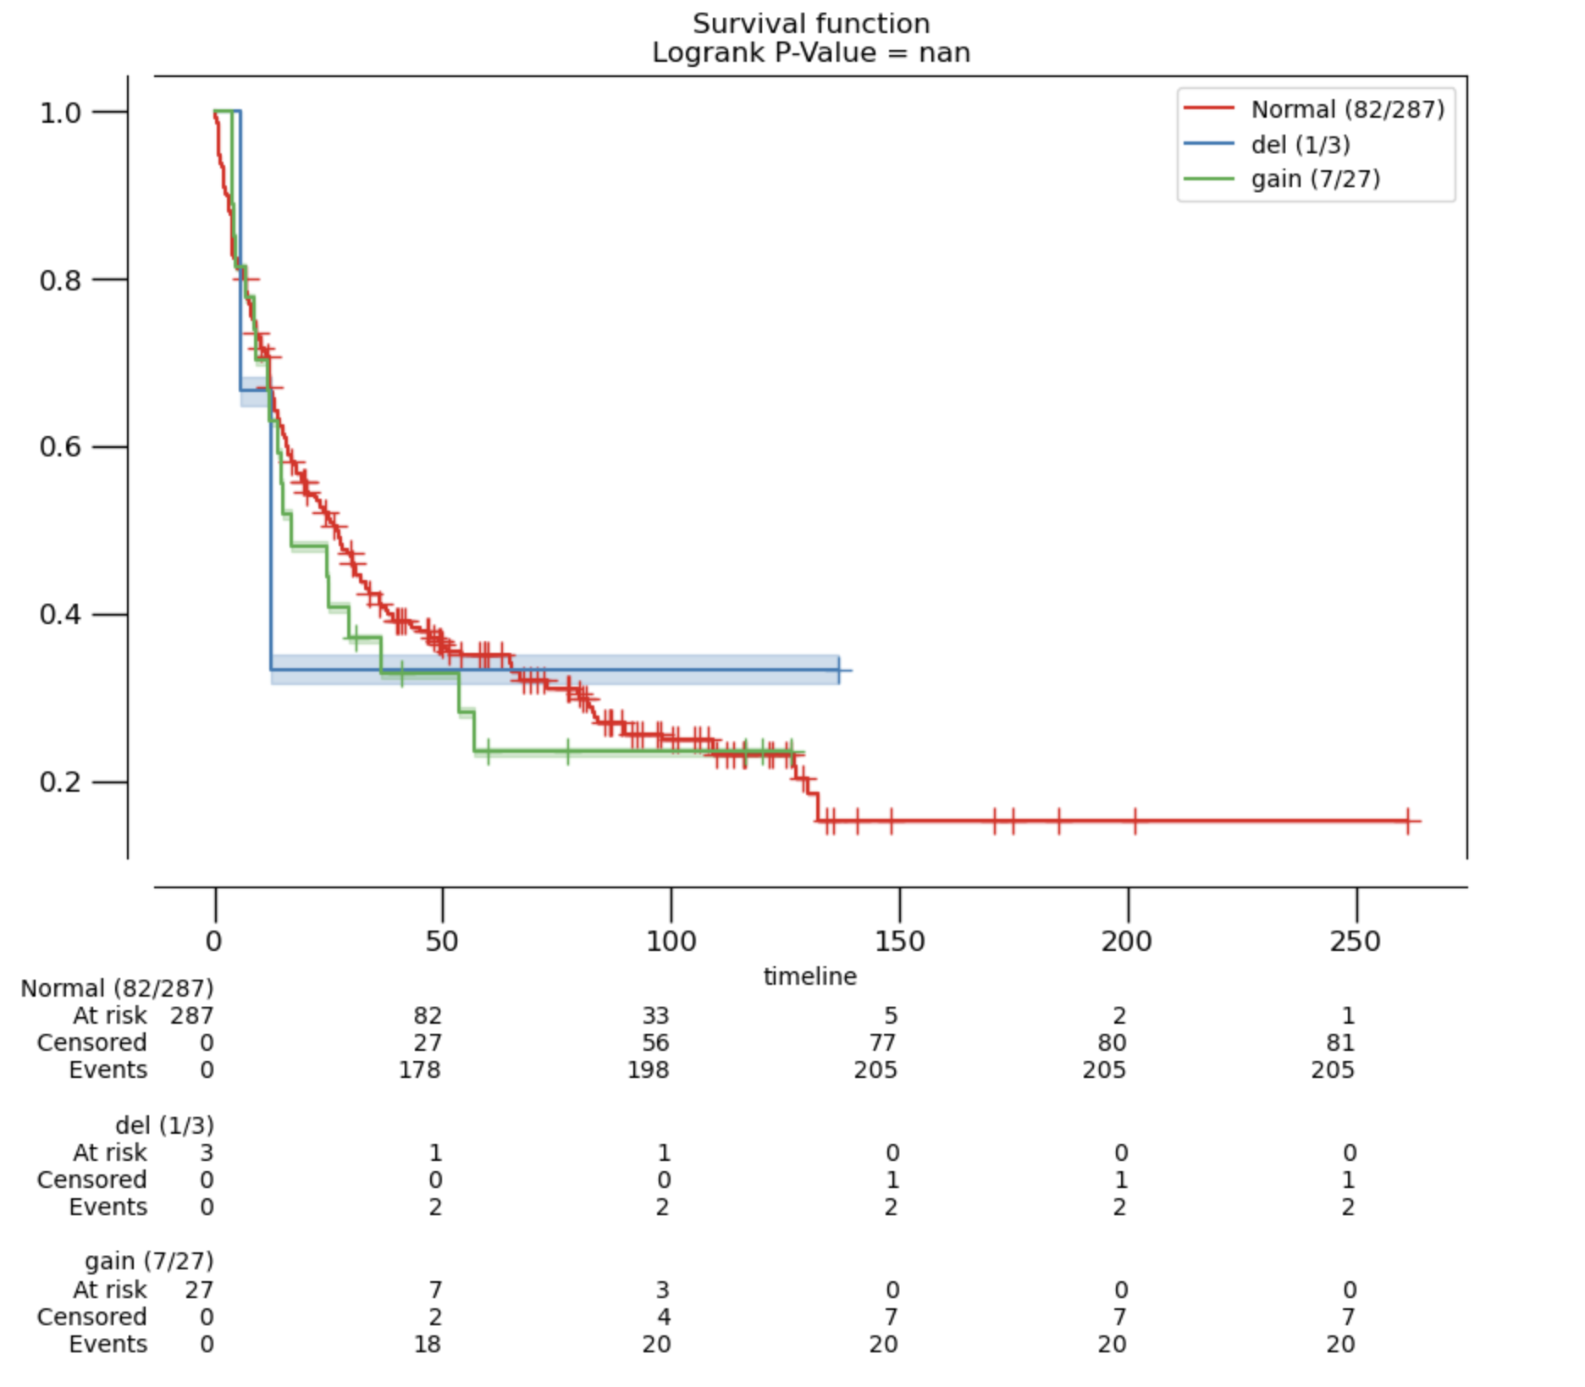
Survival Analysis DLBCL: -17p and +8q
total DLBCL cohort: n = 317
-17p: TP53
+8q: MYC
survival
survival
time [months]

Slide 11
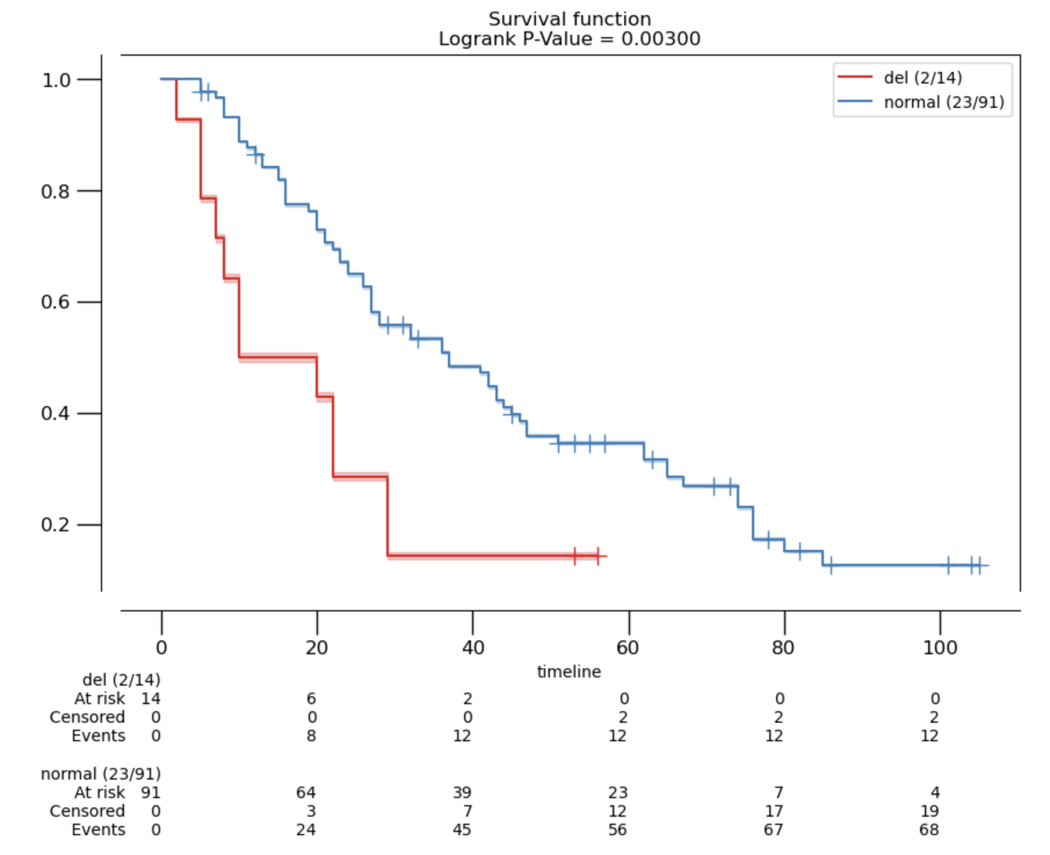
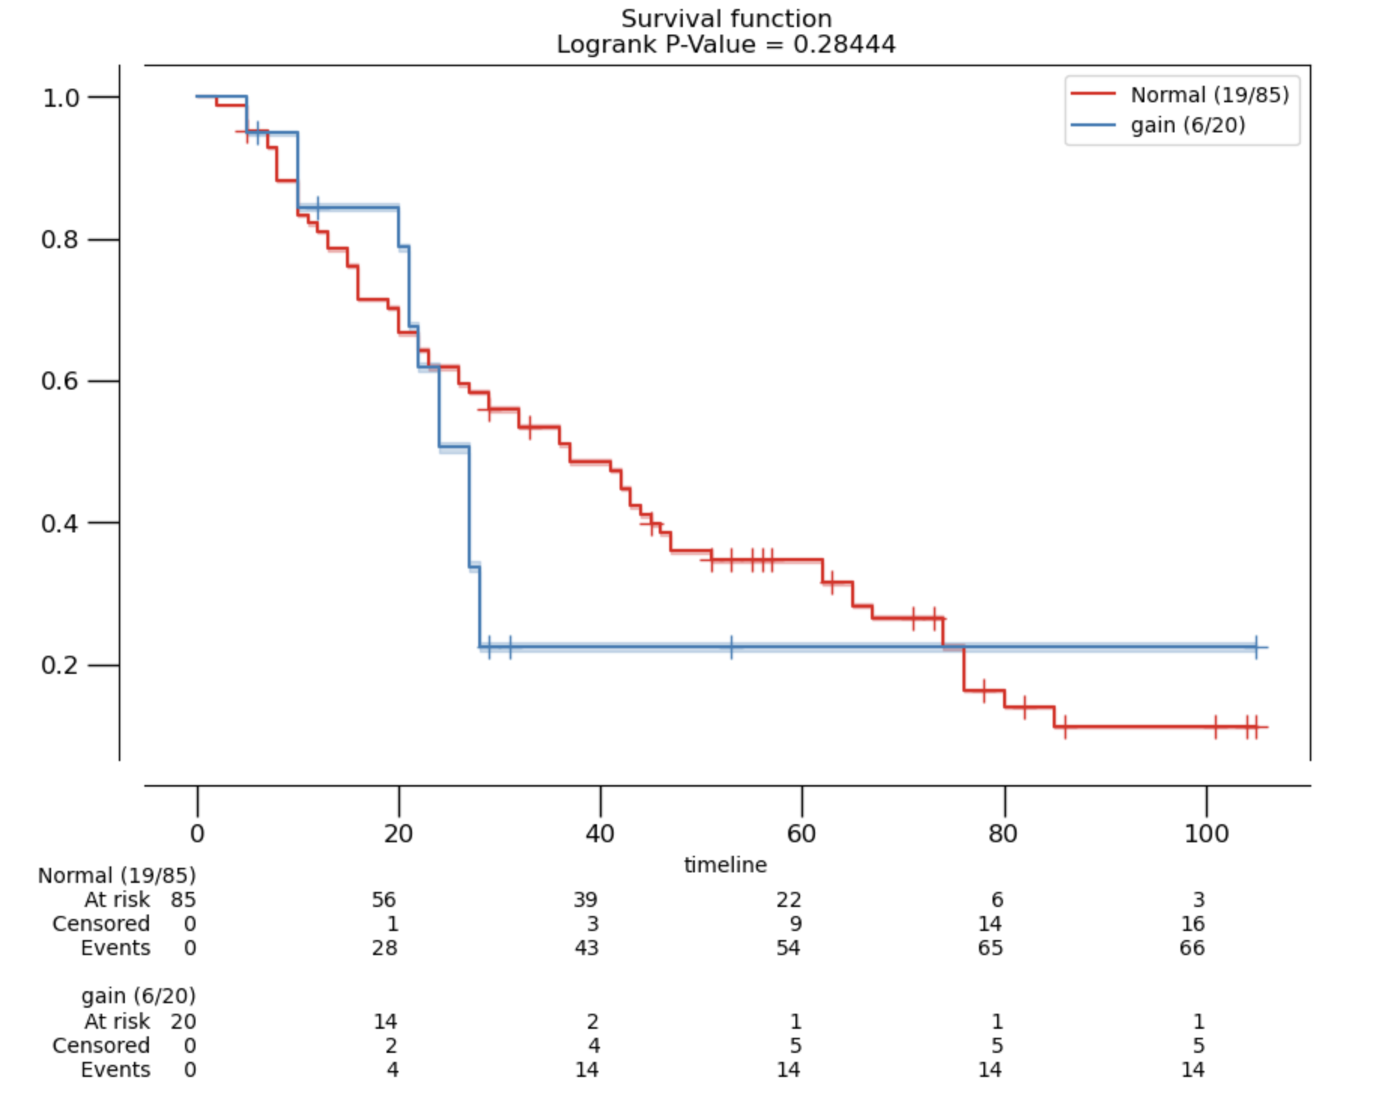
Survival Analysis MCL: -17p and +8q
total MCL cohort: n = 105
-17p: TP53
+8q: MYC
logrank P-value = 0.003
survival
survival
time [months]
Eskelund, Christian W et al. “TP53 mutations identify younger mantle cell lymphoma patients who do not benefit from intensive chemoimmunotherapy.” Blood vol. 130,17 (2017): 1903-1910. doi:10.1182/blood-2017-04-779736
Notes:
univariate model, mutations of TP53 (11%) and NOTCH1 (4%), and deletions of TP53 (16%) and CDKN2A (20%), were significantly associated with inferior outcomes (together with MIPI, MIPI-c, blastoid morphology, and Ki67 > 30%); however, in multivariate analyses, only TP53 mutations (HR, 6.2; P < .0001) retained prognostic impact for overall survival (OS)

Slide 12
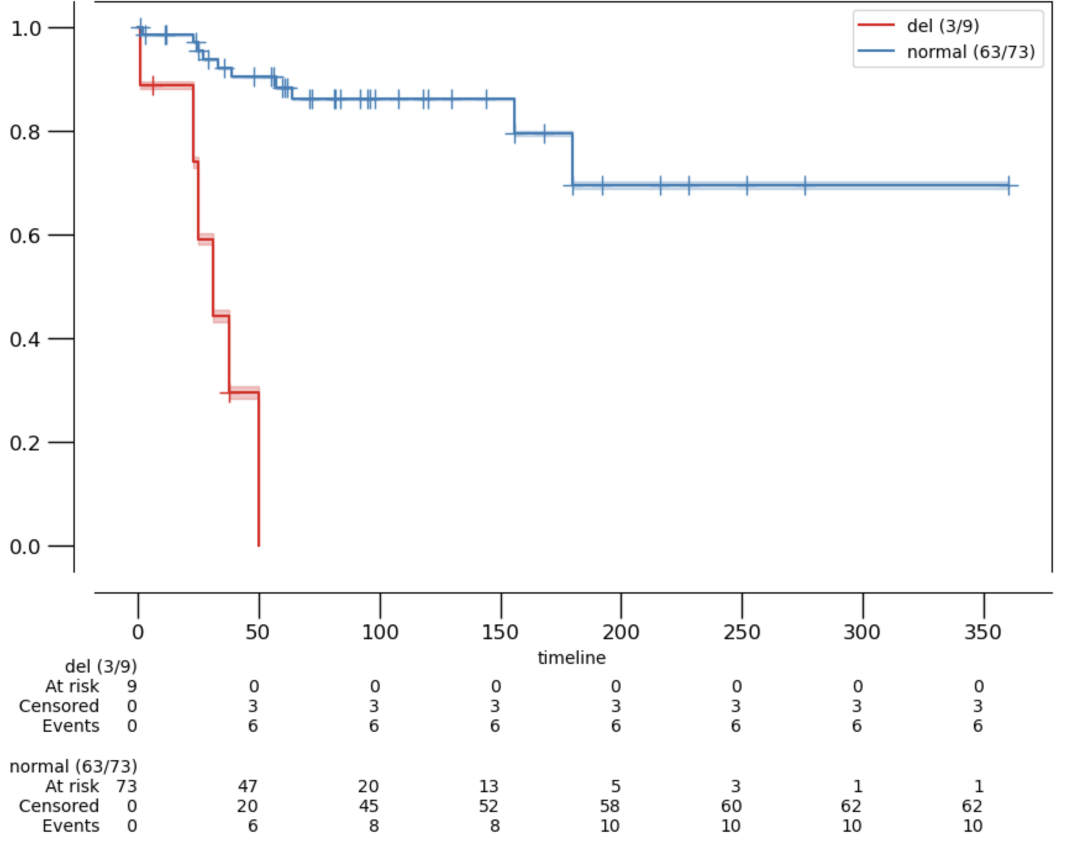
Survival Analysis CLL: -17p
total CLL cohort: n = 82
logrank p-value = 0.00000
survival
time [months]

Slide 13
Conclusions
-17p and +8q is found in a variety of hematolymphoid neoplasms
no significant prognostic impact of +8q in MCL and DLBCL patients
-17p is associated with poor survival in MCL and CLL
MCL and DLBCL cohorts are not representative with regard to 5-year-OS
Univariate analysis may be misleading

